Slide 1
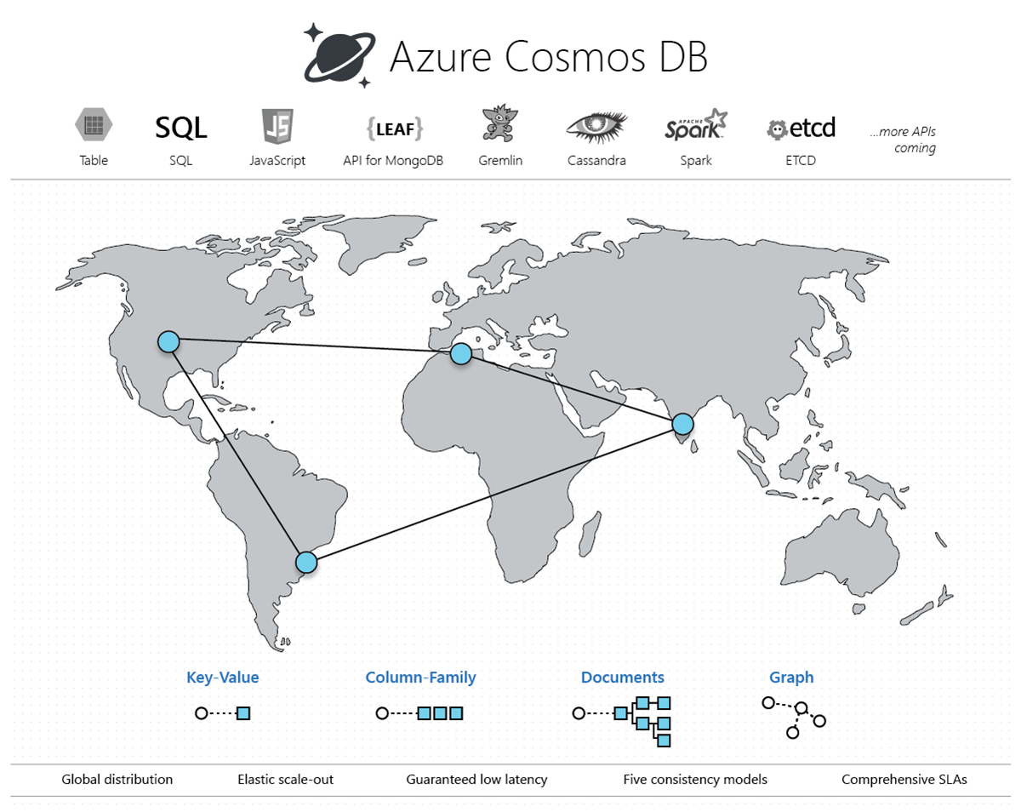
Introduction to Azure Cosmos DB
By : Amir Ismail

Slide 2
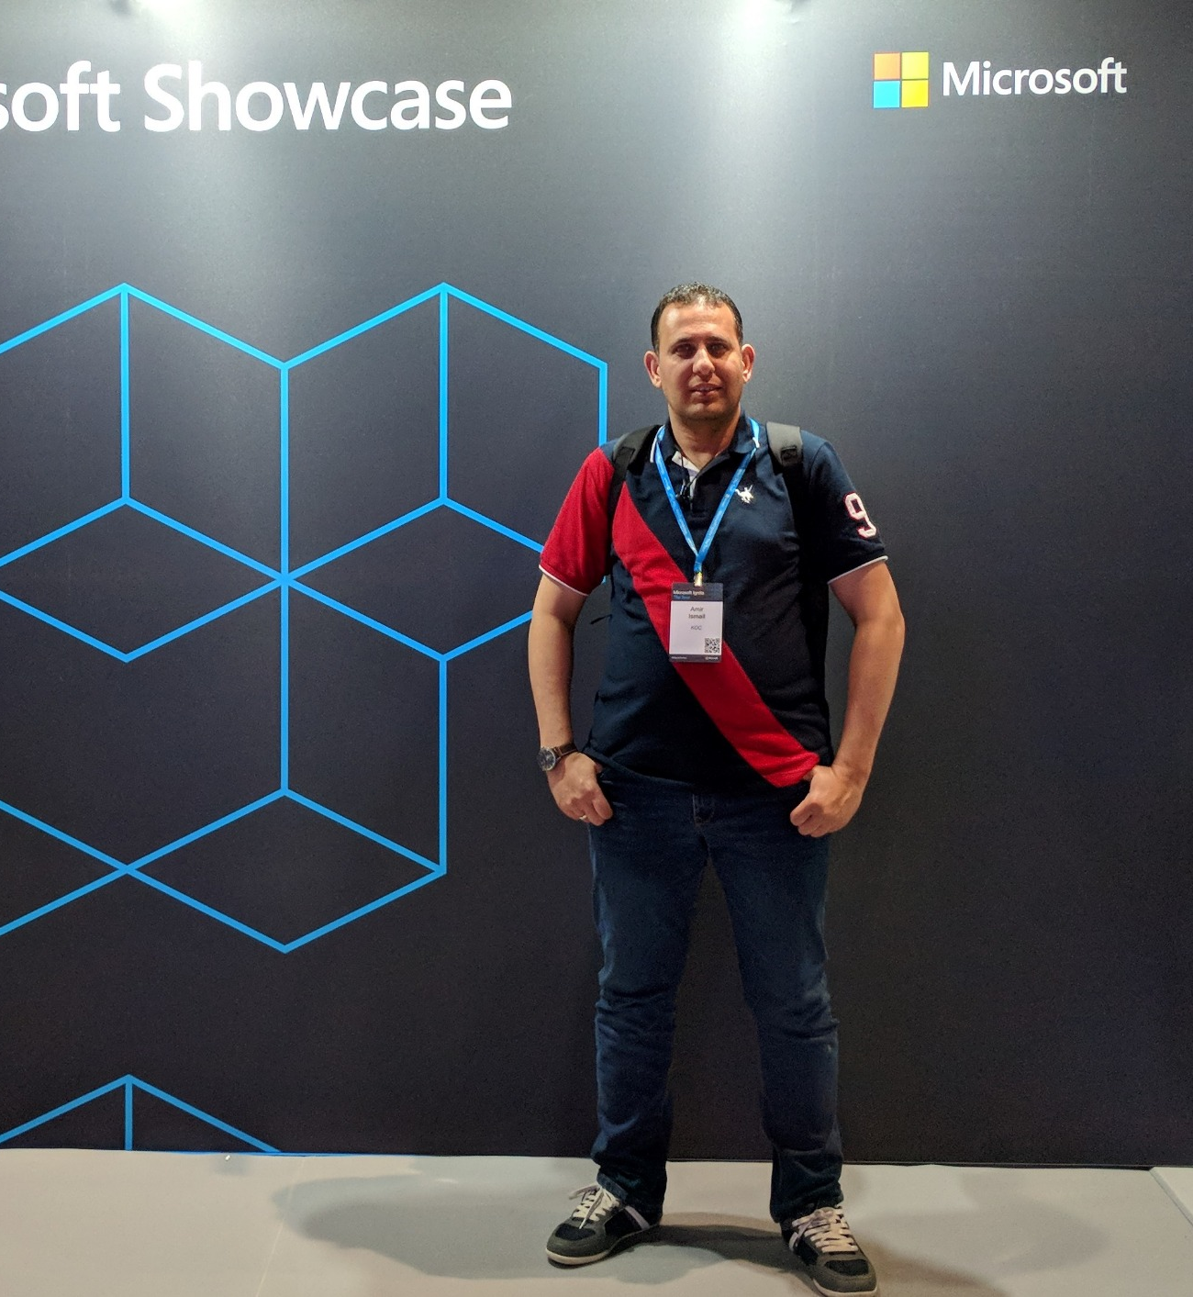


Amir Ismail
Overview
Senior Software Engineer with +15 years of experience in Software Engineering. I participated in multiple projects in different business domains range like E-learning, Banking, Oil, E-booking and Hotels management.
Certifications
PSM I.
ITIL®.
PRINCE2®.
ICAgile – ICP
Azure Fundamental
Contact Details
https://www.linkedin.com/in/amirismailyousef/
@miroprocessor

Slide 3
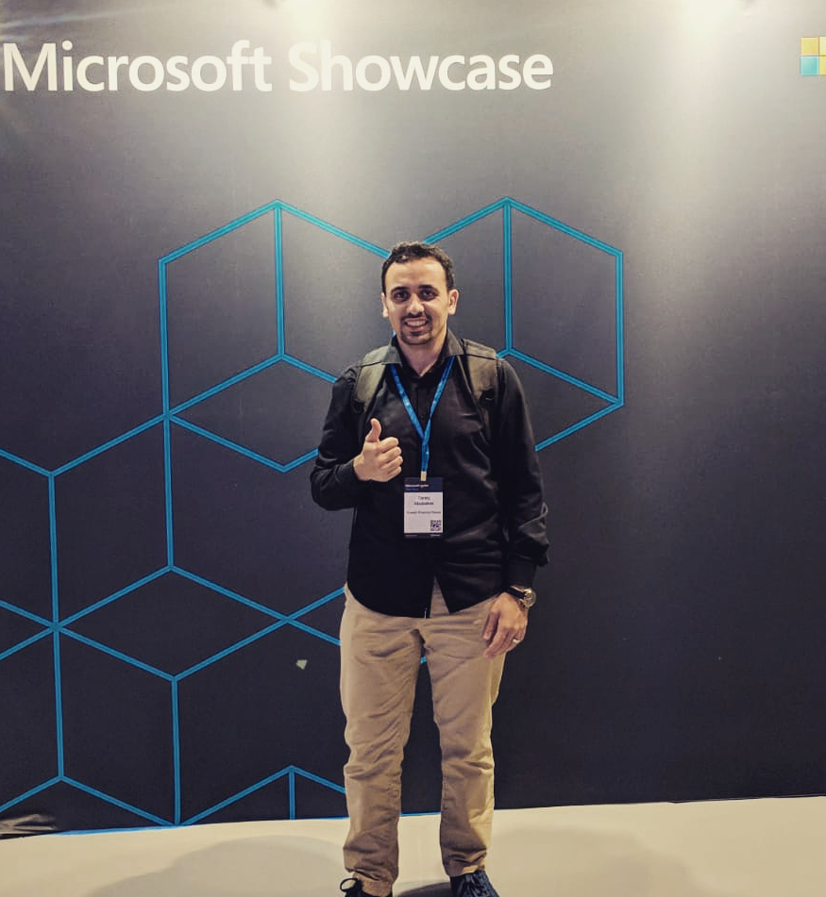
Tariq Abubaker
Overview
IT Enterprise Architect for Kuwait Finance House.
+10 years of experience in the IT and banking industry. I participated multiple projects range from SOA, EA, Core banking, Payment Solutions, Credit Cards, AML and Fraud, CRM, Retail, Finance, and IT service management solutions.
Certifications
TOGAF® 9.
DevOps.
MCTS: .NET Framework 4, Web Applications.
MCP
ICPAgile – ICP
Contact Details
https://www.linkedin.com/in/tariq-abubaker/
@taq_abubaker

Slide 4
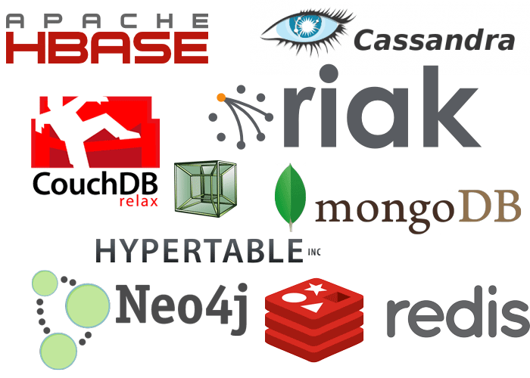
What is NoSQL?
NoSQL (non SQL, non relational, Not only SQL) database.
Exists since 1960s
NoSQL term is introduced by Carlo Strozz in1998.
Increasingly used in Big Data and Real Time applications
No Tables and Columns
Avoid Joins
https://www.getfilecloud.com/blog/2014/08/leading-nosql-databases-to-consider/#.XfOxdegzaMq

Slide 5
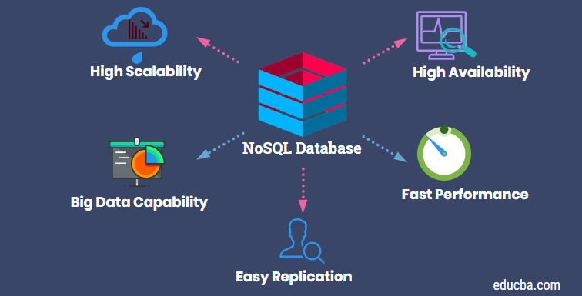
NoSQL Database Characteristics
Simplicity of design
Easy to horizontal scaling to clusters
Control over availability
Limiting the object relational impedance mismatch
No constraints on data types and consistency.
Fast and Flexible

Slide 6
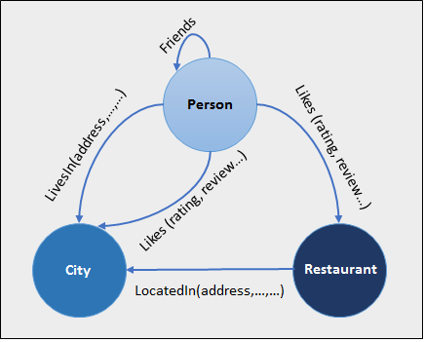
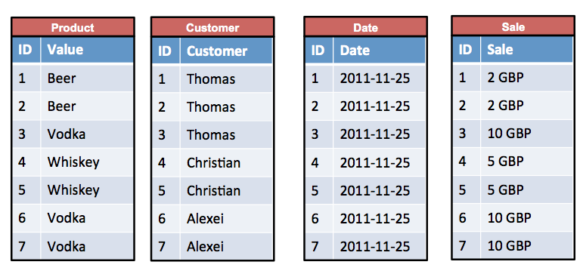
Types of NoSQL Databases
Graph Databases
Nodes for data and edges for connections(relation).
Supports richer representation of data relationships.
Used in systems must map relationships like reservation systems and CRM
Ex : Neo4j, IBM Graph, Titan
Wide Column Databases
Organize data tables as columns not rows.
Exists in SQL and NoSQL
Retrieving data is faster than relational databases specially
with large data volumes.
Recommendation engines, fraud detection and catalogs.
Ex : Google BigTable, Cassandra, HBase

Slide 7
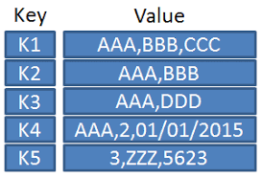
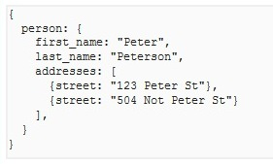
Types of NoSQL Databases
Key-value Databases
Simple data model that pairs a unique key with its value in storing
data element.
Helpful in sessions management and caching.
Ex : Aerospike, Redis and MemchacheDB
Document Databases
Objects/Entities is represented as JSON.
Objects/Entities combined in containers or collections.
Can be used in Content Management and mobile application data handling.
Ex : Cosmos DB, MongoDB, CouchDB

Slide 8

NoSQL ≠ No Schema or Schemaless
NoSQL = Flexible Schema

Slide 9
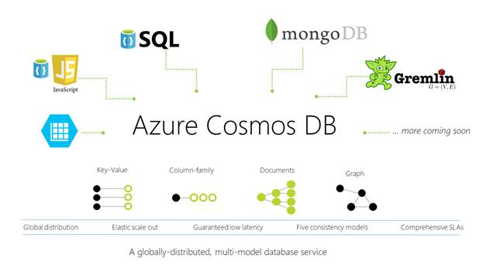
What is Azure Cosmos DB?
Azure Cosmos DB is Microsoft's globally distributed, multi-model database service.
It enables you to elastically and independently scale throughput and storage across any number of Azure regions worldwide
Using your favorite API including SQL, MongoDB, Cassandra, Tables, or Gremlin.

Slide 10
Benefits of Azure Cosmos DB
Turnkey global distribution
It enables to build highly responsive and highly available applications.
It transparently replicates your data and users can interact with replica that is closest to them.
Always On
It provides five 9s (99.999%) high availability for both read and write.
It provide the ability to programmatically invoke the regional failover of your Cosmos account.
Elastic scalability of throughput and storage
Horizontal partitioning and multi-master replication
Elastic scalability for your writes and reads.
You can scale from thousands to hundreds of million of requests/sec.
Guaranteed low latency at 99th percentile
Cosmos DB guarantees less than 10-ms latencies for both, reads (indexed) and writes at the 99th percentile.

Slide 11
Benefits of Azure Cosmos DB
Multiple consistency choices
Cosmos DB’s multi-master replication protocol is carefully designed to offer 5 consistency choices
Strong
Bounded staleness
Session
Consistent prefix
Eventual
No schema or index management
Cosmos DB is fully schema-agonistic.
No downtime while migrating schemas.
Cosmos DB automatically indexes all data and serves queries very fast.

Slide 12
Benefits of Azure Cosmos DB
Secure by default
All data in cosmos DB is encrypted at rest an motion.
Significant TCO savings (TCO = Total Cost of Ownership)
Cosmos DB is fully managed service.
No need to
manage and operate complex datacenters .
Deploy and upgrades of your database software.
Pay for support.
Licensing.
Have to provision for the peak workload

Slide 13
Create Azure Cosmos DB – Azure Portal
https://azure.microsoft.com/en-us/try/cosmosdb/
Demo

Slide 14
Azure Cosmos DB Item metadata
Property | Description | Data Type | Is system generated?
id | unique name that identifies the document. Ex: "id": "14888b30-3984-4611-9ffd-44f55b8b3fd5" | string | if not exist
_rid (resource ID) | unique identifier that is also hierarchical per the resource stack on the resource model, used internally for placement and navigation of the document resource. Ex: "_rid": "WVNWAJl9IVtYAAAAAAAAAA==" | string | Yes
_ts | specifies the last updated timestamp of the resource. Ex: "_ts": 1576999453 | timestamp | Yes
_self | unique addressable URI for the resource. Ex: "_self": "dbs/WVNWAA==/colls/WVNWAJl9IVs=/docs/WVNWAJl9IVtYAAAAAAAAAA==/" | string | Yes
_etag | specifies the resource etag required for optimistic concurrency control. Ex: "_etag": "\"79003433-0000-0200-0000-5dff1a1d0000\"" | string | Yes
_attachments | specifies the addressable path for the attachments resource. Ex: "_attachments": "attachments/" | string | Yes

Slide 15
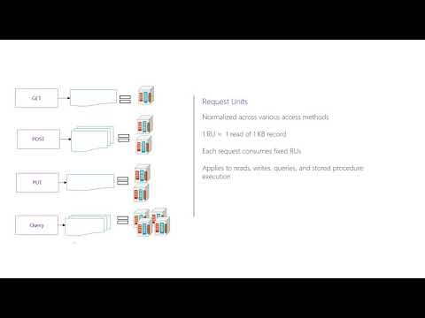
What is Request Unit (RU)?

Slide 16
What is Request Unit (RU)?
Cosmos DB unit to measure throughput of your database.
Request unit usage is measured per second.
You must determine the RU/s you want Cosmos DB to provision in advance so it can handle the load.
You can scale RU/s up and down at any time.
CPU+IOPS+Memory required to perform database operations

Slide 17
Request Unit (RU) basics
1 RU ≈ cost of single GET request on a 1 KB document using document ID.
Using document ID is the most efficient mean to retrieve documents.
Create/Retrieve/Update/Delete same item costs 1 RU for each operation
Provisioning RU/s in increments of 100 RUs
You are billed on an hourly basis.
No. of RU depends on:
Document size.
No. of properties.
Operation being performed.
Additional concepts (consistency and indexing policy).

Slide 18
Request Unit (RU) Considerations
You should consider the following when estimating the RU/s to provision:
Item Size
RU to read/write increases if the item size increased.
Item Indexing
By default all item in a container are indexed but if you choose to not index some items you will consume fewer RUs.
Item properties Count
By default indexing is on all properties, so the number of RUs increases with the number of properties.
Indexed properties
To reduce the RU consumption for write operations, limit the number of indexed properties.
Data Consistency
Strong consistency level consumes ≈ 2 times RUs while performing read operations.

Slide 19
Request Unit (RU) Considerations
You should consider the following when estimating the RU/s to provision:
Query Patterns
Complex queries consume RUs more than simple ones. Factors affect the cost of your query:
No. of query result.
No. of predicates(where, having,…etc.)
No of user-defined functions.
Size of the source data.
Size of the result set.
Projections (subset of properties, column).
Cosmos ALWAYS consumes same RUs for the same query.
Script usage
Stored procedure and triggers consumes RUs based on the complexity of the operations that are performed.

Slide 20
Partitioning in Azure Cosmos DB
Partition Strategy
Adding new data to a single server/single partition, it will run out of space.
To scale out you need to partition your containers.
Scale out strategy in cosmos is driven by Partition Key.
Partition Keys
It is the value/property by which azure organizes your data into logical divisions.
Its aim is to distribute operations across your database to avoid hot partitions.
Hot partition is a single partition receives many more requests than others and may cause a bottleneck.
The max storage space for each partition is 10GB (physical partition)
If you are using separate keys for partitioning and your data for one key may exceed the limit think about using composite key for partitioning like ID+Date
Partition Key can NOT be changed without re-creating the container.

Slide 21
Partitioning in Azure Cosmos DB
Best Practices
Don’t be afraid of choosing a partition key that has a large number of values. The more values your partition key has, the more scalability you have.
To determine the best partition key for a read-heavy workload, review the top three to five queries you plan on using. The value most frequently included in the WHERE clause is a good candidate for the partition key.
For write-heavy workloads, you'll need to understand the transactional needs of your workload, because the partition key is the scope of multi-document transactions.

Slide 22
Demo
Migrate to Azure Cosmos DB

Slide 23
Time to Live (TTL) in Azure Cosmos DB
Cosmos DB provides the ability to delete items/records automatically from container after certain time period.
Time to Live value is configured in seconds
Deletion of expired items is background task. If the container is overloaded and no enough RUs to delete expired items, deletion is delayed till there are enough RUs available to perform the deletion.
Though the deletion is delayed, data is not returned/read by any API after the TTL has expired.
By default TTL is set to null which means items/containers will live for ever.
Items will expire after TTL value second passed after last modified
Deleting items based on TTL is FREE. No additional RUs are consumed.

Slide 24
Time to Live (TTL) in Azure Cosmos DB
TTL on a container (set using DefaultTimeToLive)
If missing (or set to null), items are not expired automatically.
If present and the value is set to "-1", it is equal to infinity, and items don’t expire by default.
If present and the value is set to some number "n" – items will expire "n" seconds after their last modified time.
TTL on a item (set using ttl)
This property is applicable only if DefaultTimeToLive is present and is not set to null for the parent container.
If present, it override the DefaultTimeToLive value of the parent container.

Slide 25
Demo
Time to Live (TTL) in Azure Cosmos DB

Slide 26
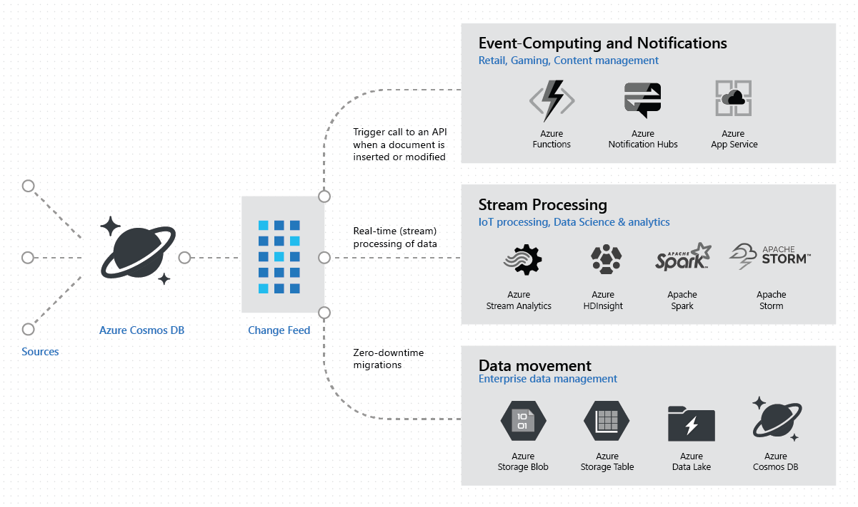
Change Feed in Azure Cosmos DB
Change feed works by listening to Azure Cosmos Container for any changes.
Change feed output is a list of documents that were changed order by modified date/time.
Changes are persisted and can be processed asynchronously and incrementally.
The output can be distributed for parallel processing.
Change feed enables you to build efficient and scalable solutions.

Slide 27
Change Feed in Azure Cosmos DB
Change feed for specific operation is NOT available.
Change feed does NOT log deletes. You can do soft delete with setting TTL on the item.
Sort order of items in change feed
Items come in the order of their modification time. This order is guaranteed per logical operation partition key.
Change feed in multi-region Azure Cosmos accounts
In multi-region, if write-region is fails over, change feed will work across the manual failover operation and will be contiguous
Change feed and Time to Live (TTL)
If the data not deleted, it will remain in the change feed

Slide 28
Change Feed in Azure Cosmos DB
Features of change feed
it is enabled by default for all Azure Cosmos Accounts.
Use your provisioned throughput to read from the change feed like any other Cosmos DB operation in any region associated with your Cosmos DB.
Each change to an item appears ONLY once in the change feed and the clients must manage check pointing logic
Only the most recent change for a given item is included in the change log. Intermediate changes may not be available.

Slide 29
Change Feed in Azure Cosmos DB
Change feed processor
It is part of Azure Cosmos DB SDK V3. it simplifies the process of reading the change feed and distribute the event processing across multiple consumer effectively.
Components of the change feed processor
The monitor container :
Has the data from which the change feed is generated
The lease container :
acts as a state storage and coordinates processing the change feed across multiple workers
Can be stored in same Cosmos account as the monitored container or in a seperate account.
The host
An application instance that uses the change feed processor to listen for changes.
Multiple instance with same lease configuration can run in parallel but instance name should be different
The delegate
The code that defines what you, the developer, want to do with each batch of changes that the change feed processor reads.

Slide 30
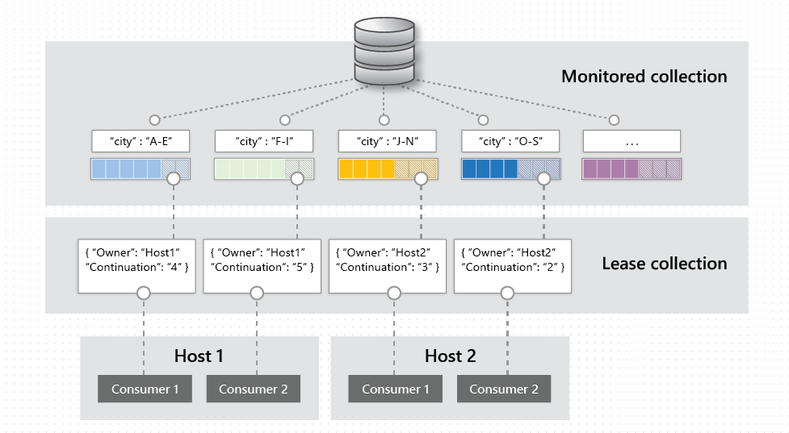
Change Feed in Azure Cosmos DB
NOTE:
You are charged for RUs consumed, since data movement in and out of Cosmos containers always consumes RUs. You are charged for RUs consumed by the lease container

Slide 31
Demo
Change Feed in Azure Cosmos DB

Slide 32
Cosmos DB vs Dynamo DB vs Firebase
System Properties Comparison
https://db-engines.com/en/system/Amazon+DynamoDB%3BFirebase+Realtime+Database%3BMicrosoft+Azure+Cosmos+DB
DB-Engines Ranking
https://db-engines.com/en/ranking_trend/system/Amazon+DynamoDB%3BFirebase+Realtime+Database%3BMicrosoft+Azure+Cosmos+DB

Slide 33
Recommended Readings
Work with NoSQL data in Azure Cosmos DB
https://docs.microsoft.com/en-us/learn/paths/work-with-nosql-data-in-azure-cosmos-db/
Data modeling in Azure Cosmos DB
https://docs.microsoft.com/en-us/azure/cosmos-db/modeling-data
How to model and partition data on Azure Cosmos DB using a real-world example
https://docs.microsoft.com/en-us/azure/cosmos-db/how-to-model-partition-example
Azure Cosmos DB partitioning design patterns
https://azure.microsoft.com/en-us/blog/azure-cosmos-db-partitioning-design-patterns-part-1/
Azure Cosmos DB Architecture Guides
https://gotcosmos.com/architecture

Slide 34
Resources
https://docs.microsoft.com/en-us/azure/cosmos-db
https://en.wikipedia.org/wiki/NoSQL
https://www.mongodb.com/nosql-explained
https://searchdatamanagement.techtarget.com/definition/NoSQL-Not-Only-SQL

Slide 35



Contact Us
@dotnetkw
@dotnetkw
.Net Kuwait

Slide 36

SCAN THE CODE & START YOUR Migration today
https://aka.ms/AA6923d
36

Slide 37

SCAN THE CODE & SEND US YOUR FEEDBACK!
http://bit.ly/2pDgRit
37

